Slide 1
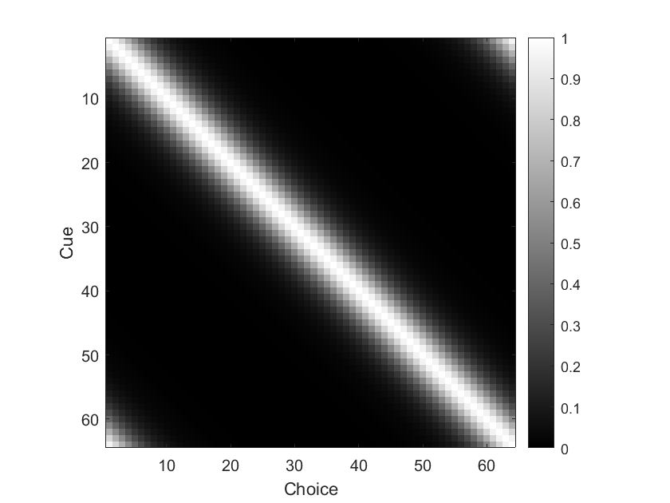
Notes:
This is a default similarity matrix
The most similar choice is the one that is identical to the cue, and similarity drops off quickly

Slide 2
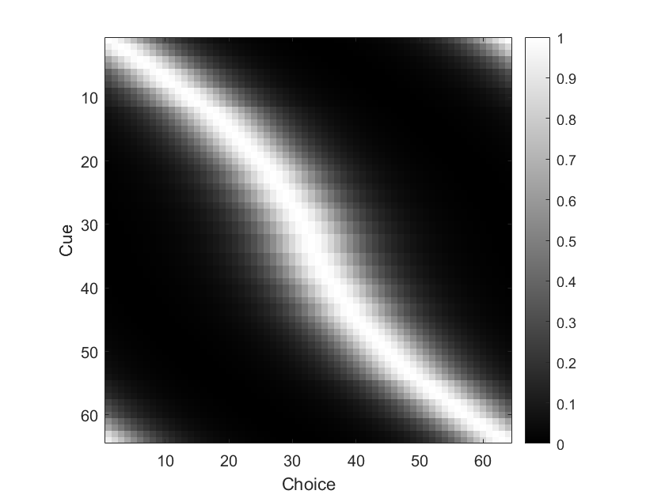
Notes:
This is a similarity matrix with biases
Each row is shifted left or right

Slide 3
Notes:
In this example, the most similar (and thus most likely to be selected) choice for cue 20 is cue 25(ish)

Slide 4
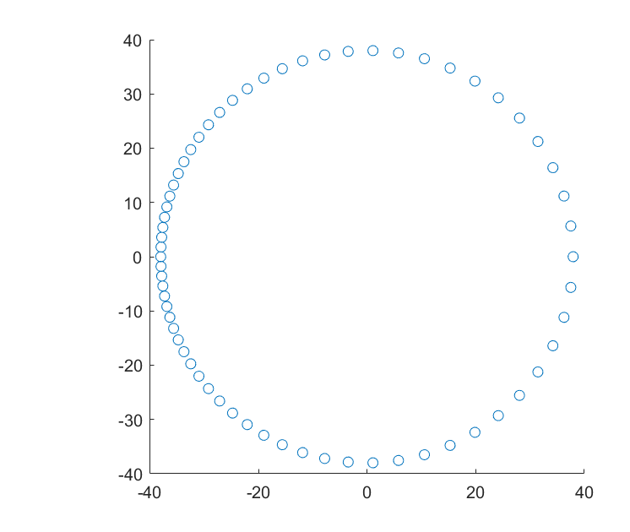
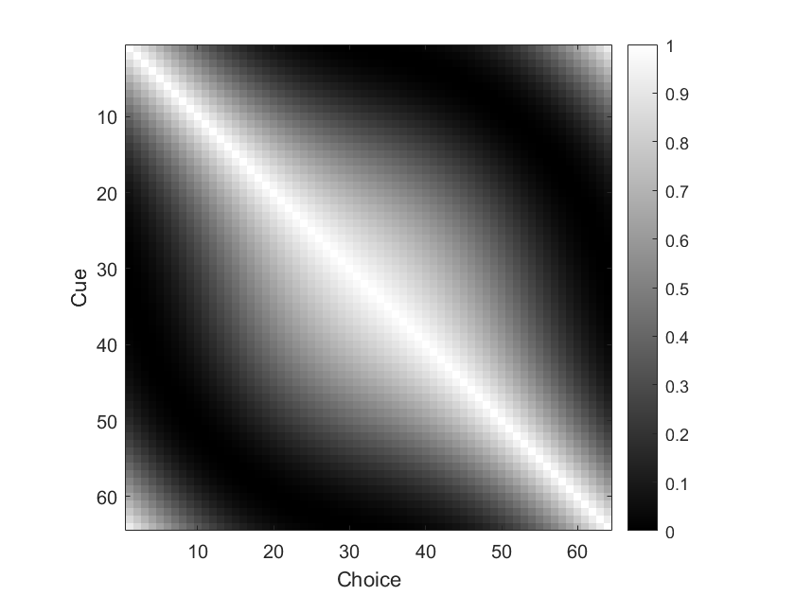
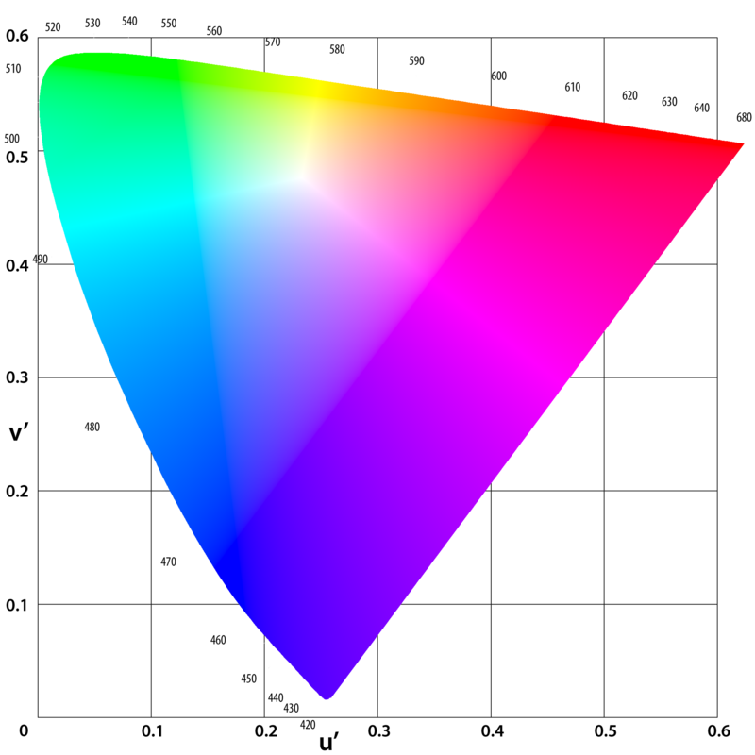
Notes:
This is a similarity matrix where there is no inherent bias, but stimuli (cues and choices alike) are unevenly distributed through colorspace (as shown in the upper left)

Slide 5
Notes:
In this case, cue 20 has roughly equal similarity to cues 15 and 40, and so responses will be skewed to higher values on average

Slide 6
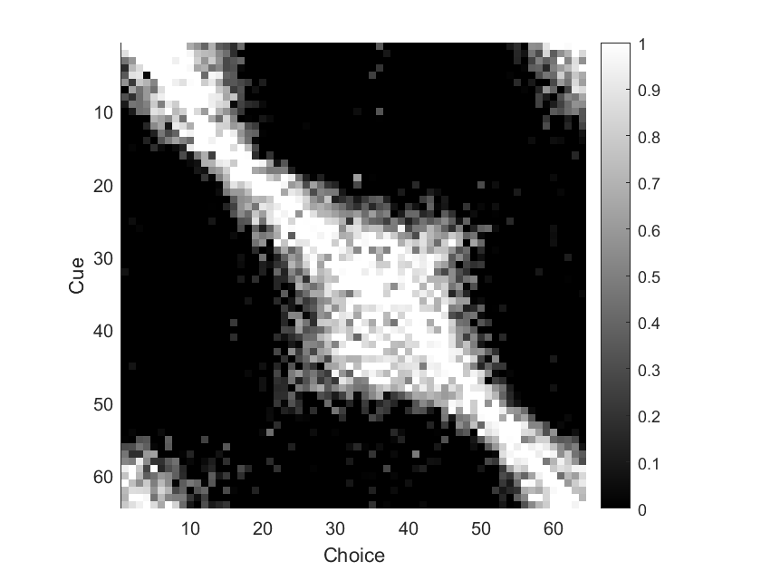
Notes:
Here’s what a model fit to our real data look like
In this model, each unit of this matrix is fit simultaneously but independently (we don’t assume any distance function between points in the colorspace)

Slide 7
Notes:
(Blue line added just to make symmetry easier to see)
You can see a roughly symmetric section in the middle (which corresponds roughly to blue/green)
This suggests that our stimuli are bunched together in this part of the space, relative to the true functional space.

Slide 8
Notes:
In the top left and bottom right you can see asymmetries across the diagonal, which can be interpreted as bias not due to inhomogeneities in colorspace.

Slide 9
Current work:
Parameterize the model such that we can fit components that directly relate to these two potential sources of bias
Allow for 2D distortions of colorspace
Compare models that allow for colorspace inhomogeneity, bias, and both.
Compute confidence intervals for fittings
Notes:
Current work:
Parameterize the model such that we can fit components that directly relate to these two potential sources of bias
Allow for 2D distortions of colorspace
Compare models that allow for colorspace inhomogeneity, bias, and both.
Compute confidence intervals for fittings

